Slide 1
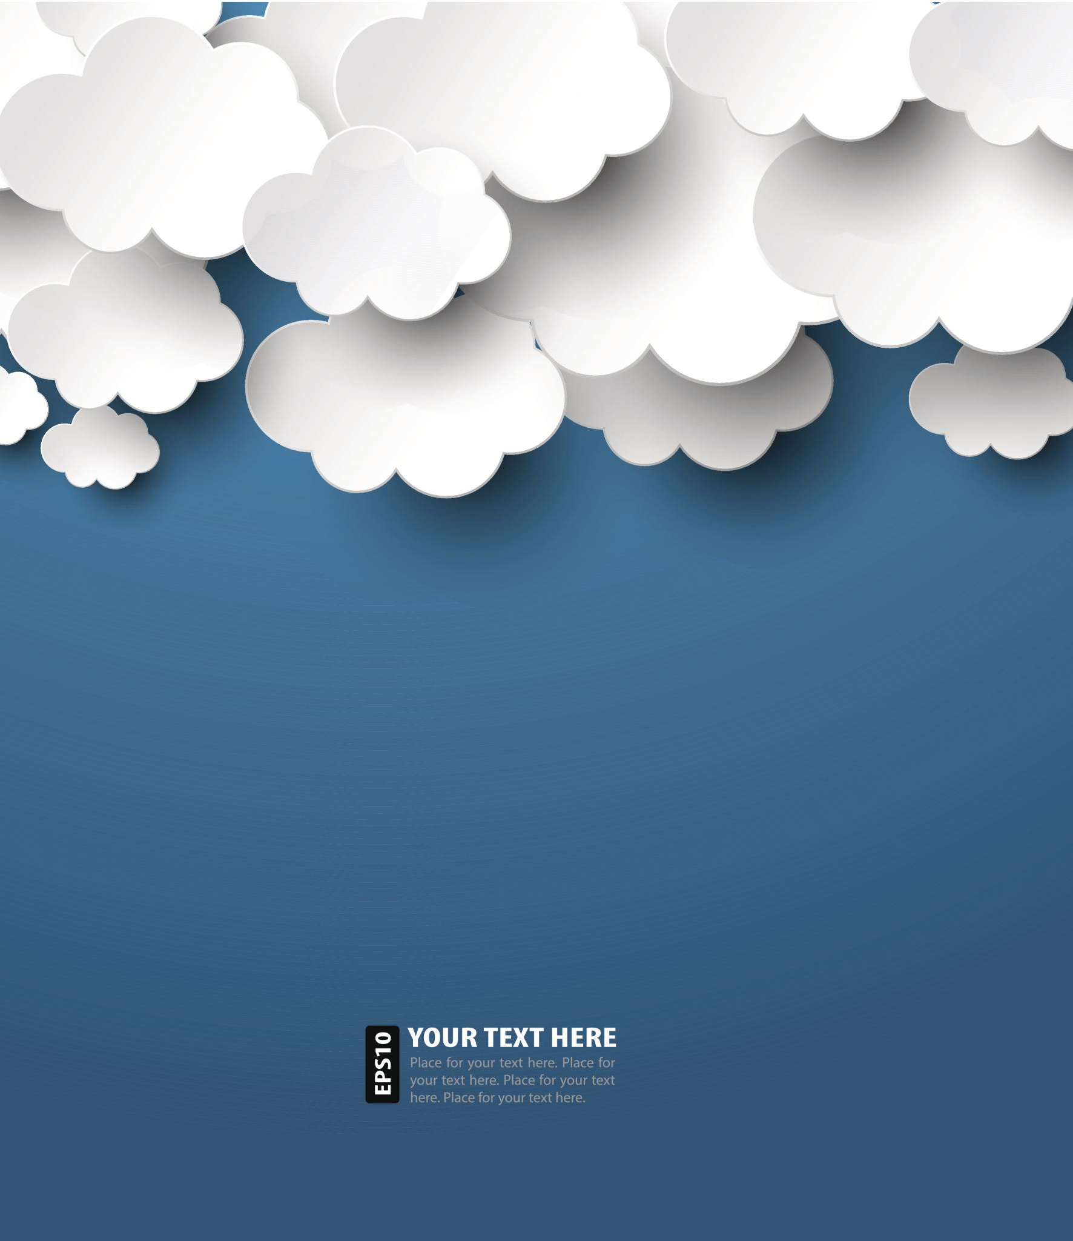
412 Individual Project
Jordan Whittington

Slide 2

Overview
I created a game and a website to house that game and all of my projects that I started
The game is called “Rouge” and the idea of the game is to use the WASD keys and the Space Bar (Attack) to try and live as long as possible against enemies that constantly spawn and chase the player

Slide 3
Roles
Core Developer: Jordan Whittington
Supporting Developers: Unity Community
Testing: Unity Game Testing Software

Slide 4
Tools
Windows 10
Piskel
Unity 2020.1.25f1
Visual Studio Code
Name.com (Domain and Hosting)
Languages: HTML, CSS, C#
Gitlab

Slide 5
Current Features (Website)
Accessible webpages
Links that take the user to my Instagram, YouTube and Gmail
Interactive buttons
Can play the game directly from the browser
Images that take the user to select videos from my YouTube when clicked
Logo in the top left of the screen that takes the user back to the homepage when clicked

Slide 6
Current Features (Game)
Respawn Feature
Enemy Hit Detection
Player Movement, Hit Detection, and Attacking
Score Tracker
High Score Tracker
Main Menu Screen and Game Over Menu Screen
WebGL uploaded onto website

Slide 7
Missing features (Game)
Global Leaderboard – I intend to include this in the game but for now I included a local high score that tracks the player’s high score on their machine. I will implement the global leaderboard into the game once I am able to figure out how to create a game server and complete the networking for the game. It was a lot more than I originally thought it was.

Slide 8
Challenges
Working Hit Boxes and Hit Detection
Gravity
Animations being displayed at appropriate times
Enemy Spawning and Visibility
Player Movement
Website’s Interactive Buttons

Slide 9
Live demo
https://unyieldinspirit.studio

